Slide 1

GIT Basics

Slide 2
Getting Started
Account creation – create your account by going to https://github.com & email your username to arunion@usf.edu so I can put you in the appropriate group/team
Download/install GIT – see install instructions document

Slide 3
Getting Started - more
ID/folder setup – see getting started instructions
Clone repositories that you work on:
Group/Team Repositories needed
------------------ ---------------------------
ABS absfam, absfbog, absgam,absgbog
AIS aisdw
OASIS oasban, oasam, oasdgwks, etc.
SAAS saas
UFA faam

Slide 4
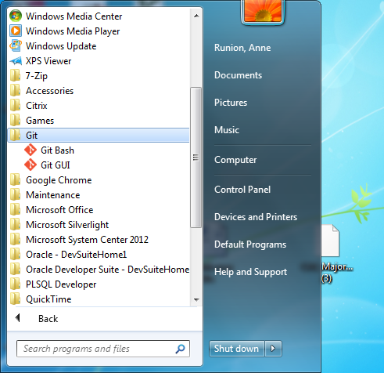
Git Bash and Git GUI
Under start→all programs→Git there should be 2 options: Git Bash and Git GUI as shown here:

Slide 5
Git Bash and Git GUI uses
Git Bash is used to check out issues and create issue folders
Git GUI is used to commit/stage/push the code and documents (.txt,.shl,.sql).

Slide 6
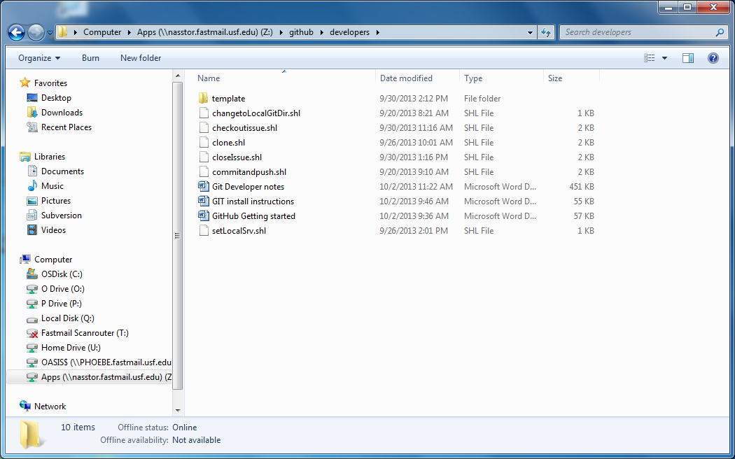
Z drive uses
The Z drive will be used to store documents/scripts.
The full path is: \\nasstor.fastmail.usf.edu\Apps\github\developers

Slide 7
Issue Request/Promotion
To request an issue/request promotion, email cmsupport@usf.edu
Issue request format will be:
Project/Repository:
OASIS Banner Development(OASBAN)
Issue Type: Improvement, Fix, etc.
Project/Issue number: 12-0232
Description: SSFAD DER maintenance
Technical Manager: Praveen Sadagopan

Slide 8
Important Dates
Conversion of production repositories –
Monday & Tuesday, 10/7-10/8
CM support unable to process issues
Live with GIT – Wednesday, 10/9
For modified objects not in PROD, extract your code from JIRA, request a GitHub issue, and promote
Our license with JIRA expires on Monday, 10/14 and SVN is gone as of Tuesday, 10/15 = modified objects not in PROD will be lost

